Slide 1
Apache Spark 2.1.0
introduction

Slide 2
Agenda

Slide 3
What is Apache Spark?
Apache Spark is a fast and general-purpose cluster computing system.
It provides high-level APIs in Java, Scala, Python and R, and an optimized engine that supports general execution graphs.
It also supports a rich set of higher-level tools including
Spark SQL for SQL and structured data processing,
MLlib for machine learning,
GraphX for graph processing, and
Spark Streaming for real-time data analysis.

Slide 4
Apache Spark Prerequisite
Spark runs on both Windows and UNIX-like systems (e.g. Linux, Mac OS).
It’s easy to run locally on one machine if,
java installed on your system PATH, or the JAVA_HOME environment variable pointing to a Java installation.
Spark runs on Java 7+, Python 2.6+/3.4+ and R 3.1+.
For the Scala API, Spark 2.1.0 uses Scala 2.11. You will need to use a compatible Scala version (2.11.x).

Slide 5
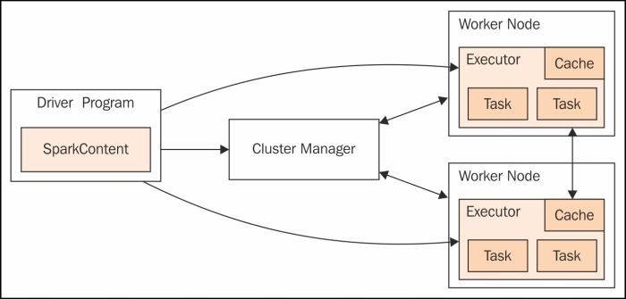
Apache Spark Execution Model

Slide 6
Spark Context
Spark context creates a virtual environment and necessary spark configurations settings into one object.
Spark applications run as independent sets of processes on a cluster, coordinated by the SparkContext object in your main program (called the driver program). Spark context often referred as sc.
Spark context denotes, the mode of deploying the execution of the submitted job(jar file). Number of executor required, memory required and so on.
Example configurations are: --master spark://207.184.161.138:7077 --deploy-mode cluster, --executor-memory 20G, --total-executor-cores 100

Slide 7
Spark Cluster Managers
Spark uses any of the following cluster managers,
Stand Alone Execution Model
Runs on top of Apache Hadoop Yarn
Runs on top of Apache Mesos cluster

Slide 8
Execution sequences
Each application gets its own executor processes, which stay up for the duration of the whole application and run tasks in multiple threads.
This has the benefit of isolating applications from each other, on both the scheduling side (each driver schedules its own tasks) and executor side (tasks from different applications run in different JVMs).
However, it also means that data cannot be shared across different Spark applications (instances of SparkContext) without writing it to an external storage system.

Slide 9
Cluster Manager Sequences
Spark is agnostic to the underlying cluster manager. As long as it can acquire executor processes, and these communicate with each other, it is relatively easy to run it even on a cluster manager that also supports other applications (e.g. Mesos/YARN).
The driver program must listen for and accept incoming connections from its executors throughout its lifetime.
It should be run close to the worker nodes, preferably on the same local area network.
If you’d like to send requests to the cluster remotely, it’s better to open an RPC to the driver and have it submit operations from nearby than to run a driver far away from the worker nodes.

Slide 10
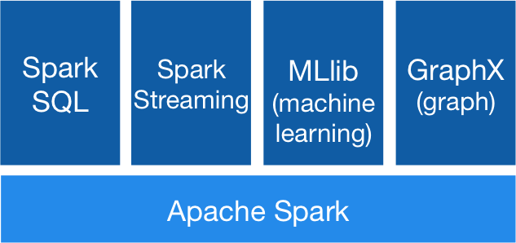
Apache Spark Technology Stack
Additional features
Structured Streaming
Big DL

Slide 11
Apache Spark Core
RDD – Resilient distributed datasets

Slide 12
What is Spark Core?
The main abstraction Spark provides is a resilient distributed dataset (RDD) which is a collection of elements partitioned across the nodes of the cluster that can be operated on in parallel.
RDDs are created by starting with a file in the Hadoop file system (or any other Hadoop-supported file system), or an existing Scala collection in the driver program, and transforming it.
Users may also ask Spark to persist an RDD in memory, allowing it to be reused efficiently across parallel operations. Finally, RDDs automatically recover from node failures.

Slide 13
Apache Spark Shared Variables
A second abstraction in Spark is shared variables that can be used in parallel operations. By default, when Spark runs a function in parallel as a set of tasks on different nodes, it ships a copy of each variable used in the function to each task. Sometimes, a variable needs to be shared across tasks, or between tasks and the driver program.
Spark supports two types of shared variables: broadcast variables, which can be used to cache a value in memory on all nodes, and accumulators, which are variables that are only “added” to, such as counters and sums.

Slide 14
What is RDD?
RDD is a fault-tolerant collection of elements that can be operated on in parallel.
There are two ways to create RDDs:
parallelizing an existing collection in your driver program,
referencing a dataset in an external storage system, such as a shared filesystem, HDFS, HBase, or any data source offering a Hadoop Input Format.

Slide 15
Parallelizing RDD
Parallelized collections are created by calling SparkContext’s parallelize method on an existing collection in your driver program (a Scala Sequence).
The elements of the collection are copied to form a distributed dataset that can be operated on in parallel. For example, here is how to create a parallelized collection holding the numbers 1 to 10
RDD is a fault-tolerant collection of elements that can be operated on in parallel.
One important parameter for parallel collections is the number of partitions to cut the dataset into. Spark will run one task for each partition of the cluster. Typically you want 2-4 partitions for each CPU in your cluster.
Sample Scala Code :
val data = 1 to 10
val distData = sc.parallelize(data)

Slide 16
Linking with Apache Spark
Linking with Apache Spark Core
Maven dependency
<!-- https://mvnrepository.com/artifact/org.apache.spark/spark-core_2.11 -->
<dependency>
<groupId>org.apache.spark</groupId>
<artifactId>spark-core_2.11</artifactId>
<version>2.1.0</version>
</dependency>
Gradle dependency
// https://mvnrepository.com/artifact/org.apache.spark/spark-core_2.11compile group: 'org.apache.spark', name: 'spark-core_2.11', version: '2.1.0

Slide 17
Scala 2.11
A Programming LANGUAGE

Slide 18
Introduction to Scala 2.11
Scala is a modern multi-paradigm programming language designed to express common programming patterns in a concise, elegant, and type-safe way.
Scala has been created by Martin Odersky and he released the first version in 2003.
Scala smoothly integrates the features of object-oriented and functional languages.
Scala is compiled to run on the Java Virtual Machine.
Many existing companies, who depend on Java for business critical applications, are turning to Scala to boost their development productivity, applications scalability and overall reliability.

Slide 19
Scala is Object-Oriented
Scala is a pure object-oriented language in the sense that every value is an object.
Types and behavior of objects are described by classes and traits.
Classes are extended by sub classing and a flexible mixin-based composition mechanism as a clean replacement for multiple inheritance.
Scala is a static-typed language

Slide 20
Scala is Functional
Scala is also a functional language in the sense that every function is a value and every value is an object so ultimately every function is an object.
Scala provides a lightweight syntax for defining anonymous functions, it supports higher-order functions, it allows functions to be nested, and supports currying.
Scala expressions are functional expressions, which are defined in lambda expressions.

Slide 21
Features of Scala
Scala runs on JVM
Scala can execute Java Classes / Programs
Scala can do Concurrent & Synchronize processing
All types are objects
Type inference and Nested Functions
Functions are objects
Domain specific language (DSL) support,
Traits and Closures
Concurrency support inspired by Erlang

Slide 22
Anonymous Function
Scala provides a relatively lightweight syntax for defining anonymous functions.
Anonymous functions in source code are called function literals and at run time, function literals are instantiated into objects called function values.
Scala supports first-class functions, which means functions can be expressed in function literal syntax, i.e., (x: Int) => x + 1, and that functions can be represented by objects, which are called function values.
Anonymous Function with parameter
Anonymous Function with multiple parameter
Anonymous Function with no parameter

Slide 23
Scala Closures
A closure is a function, whose return value depends on the value of one or more variables declared outside this function.
The following piece of code with anonymous function.
val multiplier = (i:Int) => i * 10 Here the only variable used in the function body, i * 10 , is i, which is defined as a parameter to the function. Try the following code −
val multiplier = (i:Int) => i * factor There are two free variables in multiplier: i and factor. One of them, i, is a formal parameter to the function. Hence, it is bound to a new value each time multiplier is called. However, factor is not a formal parameter, then what is this? Let us add one more line of code.

